Slide 1
Two Tank Liquid Level System
Presented by:
Ghaylen Triki
Nouha Karoui
Mehdi Ismail Ben Salah
Hazar Boughanmi

Slide 2




Team Presentation
Hazar Boughanmi
Ghaylen Triki
Nouha Karoui
Mehdi Ismail Ben Salah

Slide 3
Table of Contents
01
04
Introduction
System Regulation
Motivation goal and presentation of the benchmark
02
05
Theoretical study
Software Study
Mathematical Model
03
06
Experimental study
Technical Sales
Hardware and software conception
07
Conclusion & Perspective

Slide 4
1.
Introduction

Slide 5

Problematic
Liquid in general is commonly used in home and industry applications. But sometimes liquid can be unstable (liquid overflow, cavitation, ect..) and do damages to the system.
So what control strategies can we use to avoid that ?

Slide 6
Why Two tank liquid level system ?
It is a simple benchmark made for liquid control
Level control is a one of the most basic control strategies in most process plants such as waste water treatment, chemical, petrochemical, pharmaceutical, food, beverages, etc..
Used to ensure that the entire system can run safely, smoothly and profitably.

Slide 7
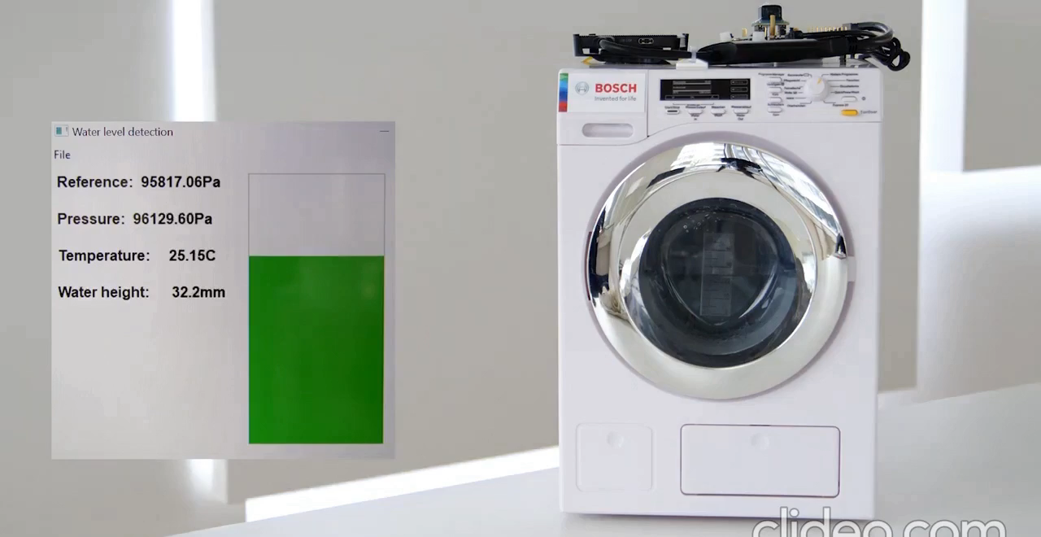

Slide 8
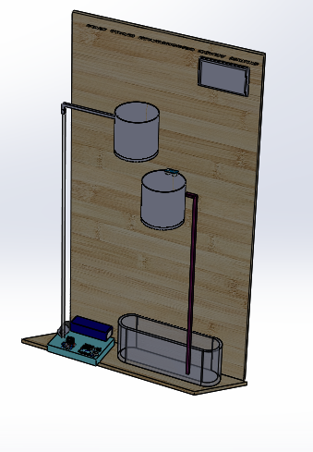
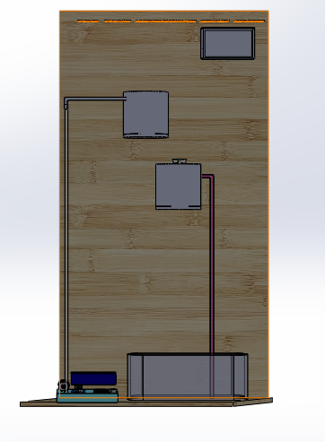

Benchmark Presentation

Slide 9
2.
Theoretical Study

Slide 10
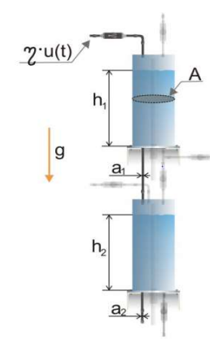
Parameters for the Coupled-Tank System
Description | Symbol | Values | Unit
Outlet area of tank 1 | a1 | 0.785 | cm²
Outlet area of tank 2 | a2 | 0.3925 | cm²
Cross-sectional area of tanks | A | 113.04 | cm²
Gravitational constant | g | 9.8 | m/sec
Constant relation the control voltage with the water flow from the pump | ƞ | 0.1194 | -
Water level in tank 1 | h1 | - | cm
Water level in tank 2 | h2 | - | cm
Voltage of the pump | u | - | V

Slide 11
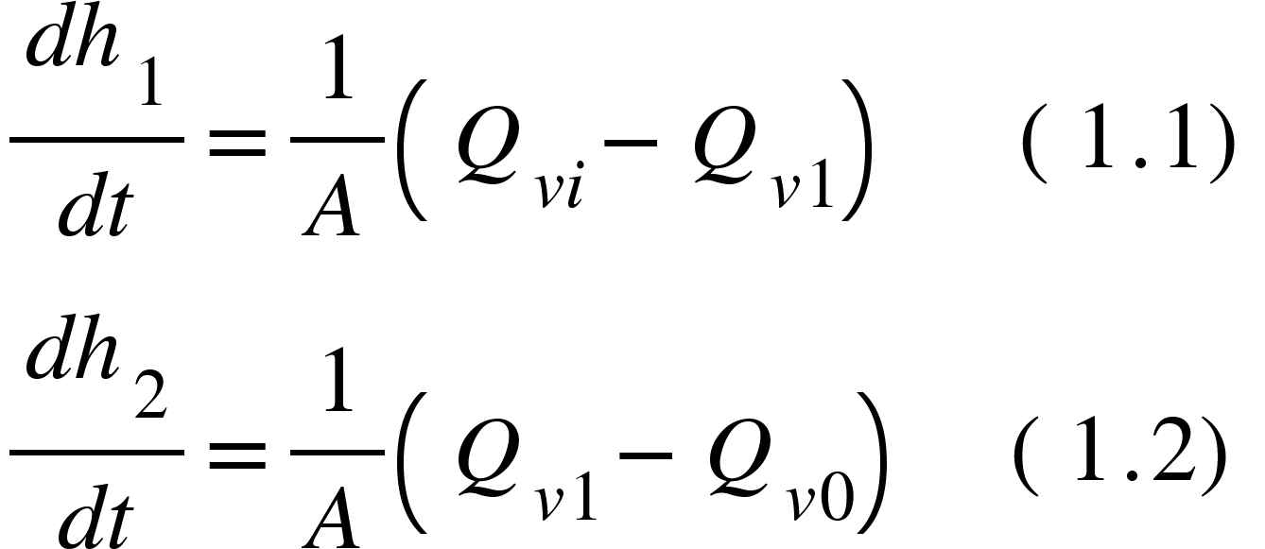
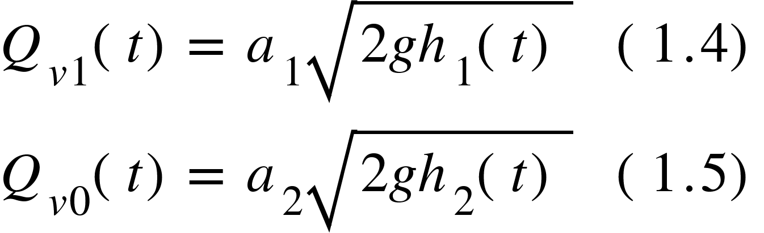
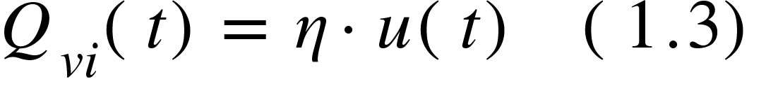
The Dynamic Equations

Slide 12
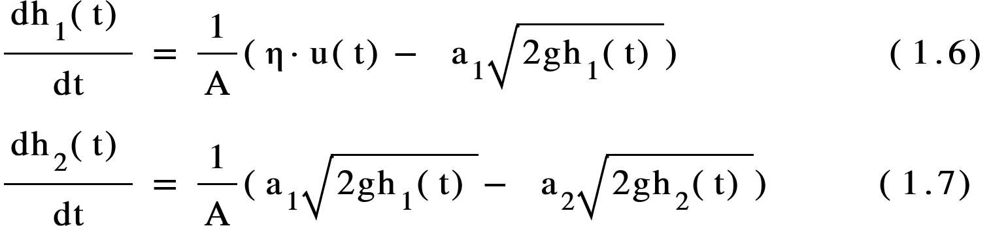
The Nonlinear Mathematical Model

Slide 13
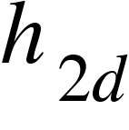
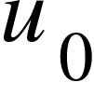
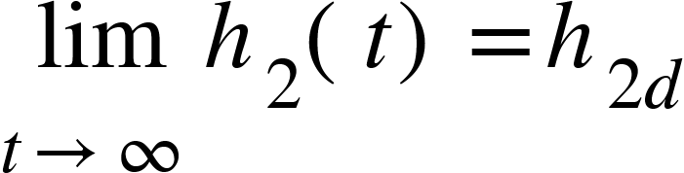
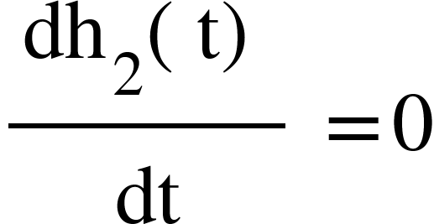
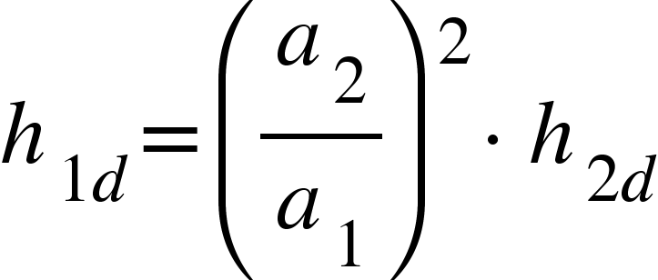
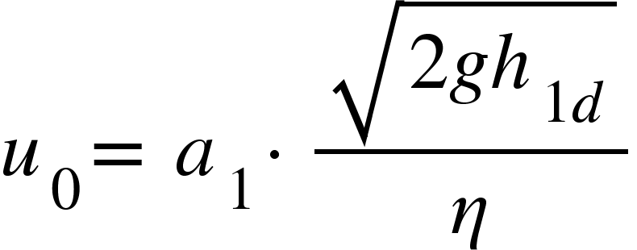
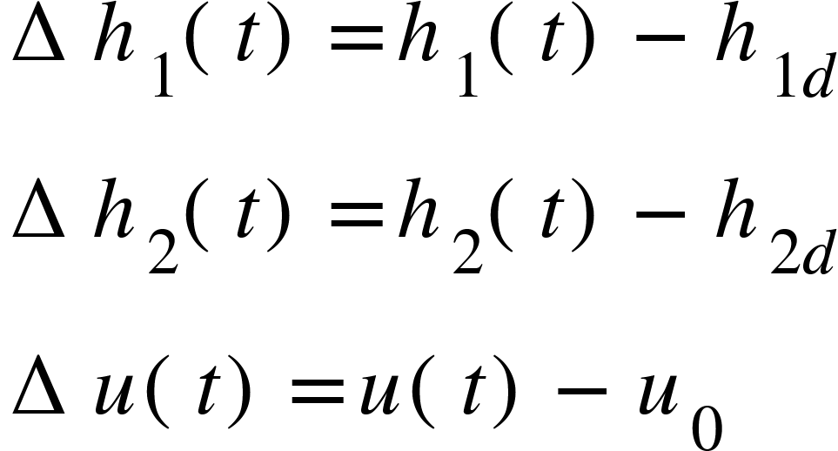
Control Objectives
Given a desired, constant, liquid level for Tank 2, denoted as , design a control input such that
Using the equations (1.6),(1.7)
To quantify this control objective, we define the liquid level tracking error for the two tanks as follows:

Slide 14
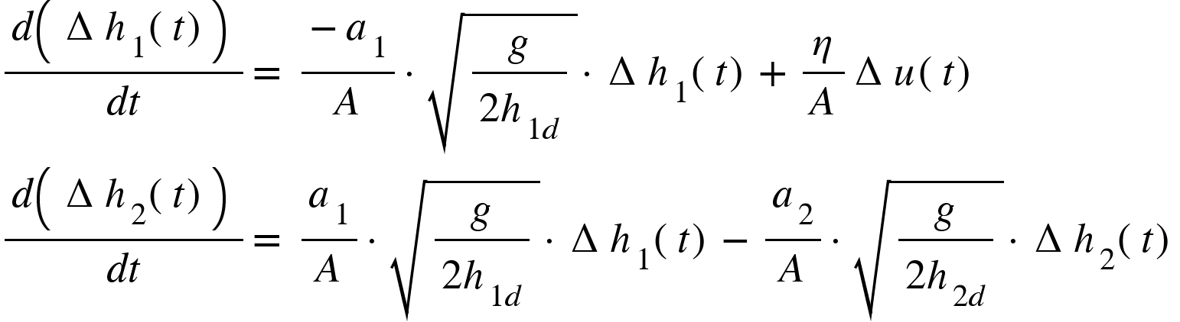
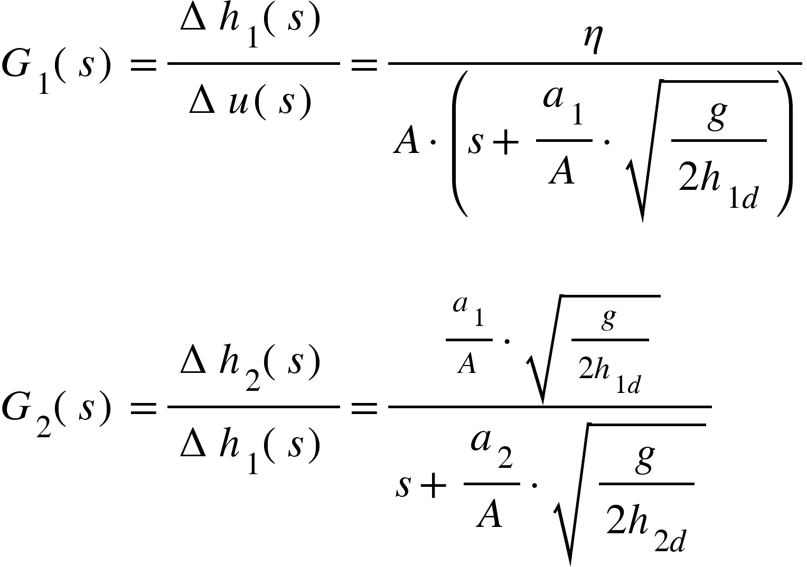
The Linearized Error System Model
The Transfer Function Model

Slide 15
3.
Experimental Study

Slide 16





Software Design

Slide 17
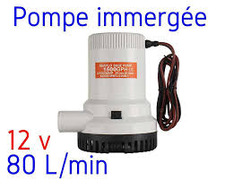
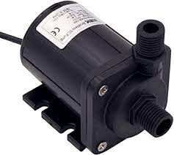
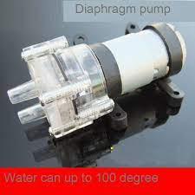
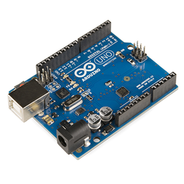
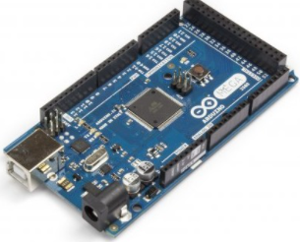
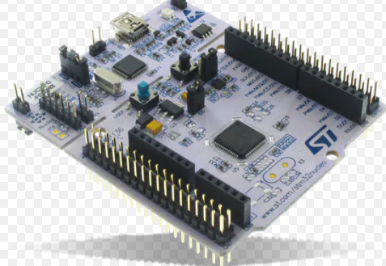
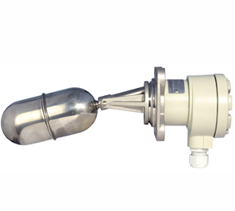
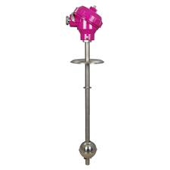
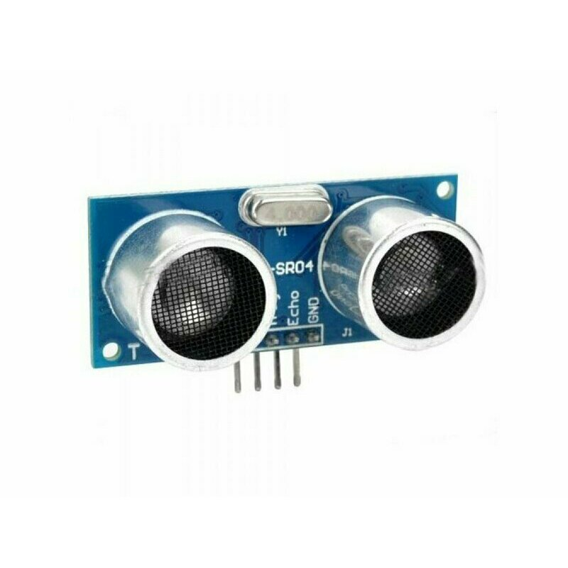
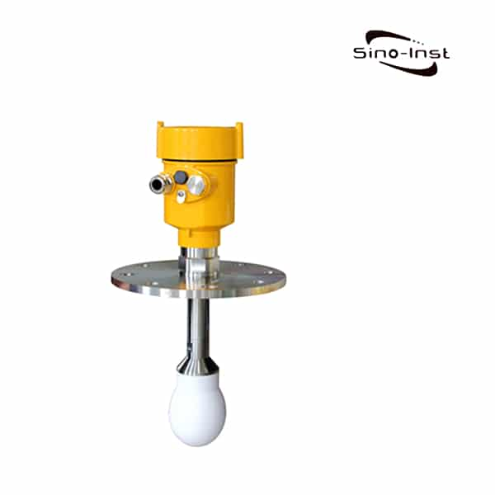
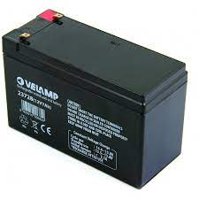


Components
Microcontrollers
STM32 Nucleo Arduino Uno Arduino Mega
Pumps
Sensors
Batteries
Magnetic Float Level Switches
Magnetic Float Level Transmitters
Ultrasonic Level Transmitters
Radar or Microwave Level Transmitters
Lipo 4S 12V
Lead acid battery 12V 7Ah
Electric battery

Slide 18

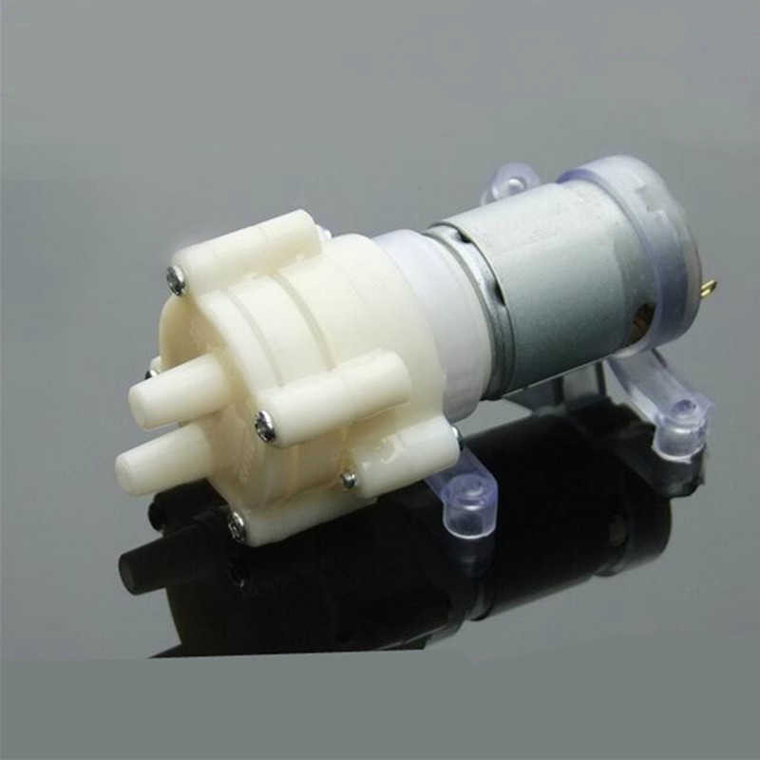
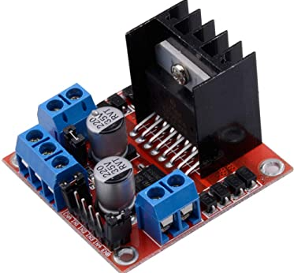

Chosen Components
Arduino Uno
Open Source,Cheap,LINX Supported Device
Ultrasonic Sensor
Accurate Results,Easy to use ,Low Price
Pump DC365
Operating voltage: DC 12V Maximum flow: 2-3 l/m
Lipo
Voltage : 12V
Number of cells : 4S
Motor Driver Controller Board
Max Intensity : 2A
Max Voltage : 48V DC

Slide 19
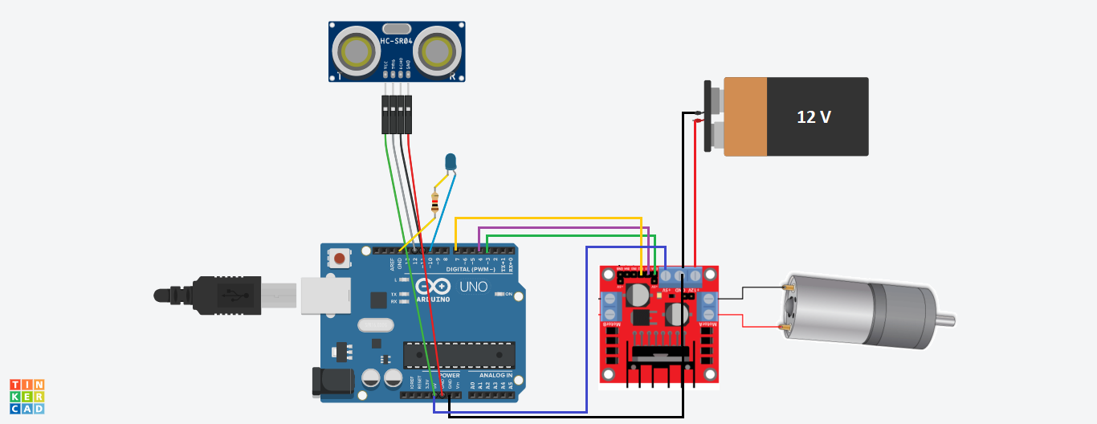
Electrical Wiring

Slide 20
4.
System Regulation

Slide 21
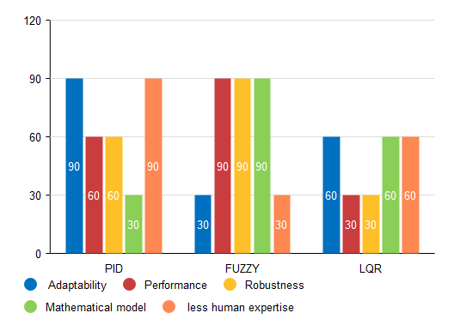
PID, fuzzy or LQR ?

Slide 22
The Characteristics of PID Controllers
 | Too Big | Too Small
Kp | The system may start oscillating | The system can have less sensitive and don’t respond
Ti | It responds to pass values so it can overshoot the SetPoint.
Td | If the system is exposed to high levels of interferences the system can become unstable | It slows the rate of change of the controller output

Slide 23
5.
Software Study

Slide 24
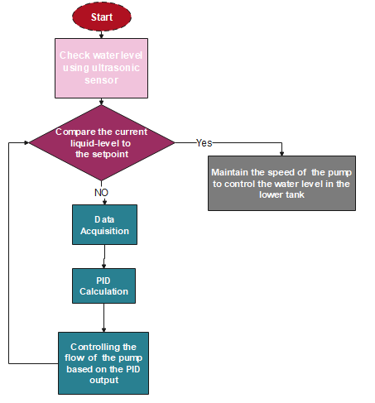
Flowchart

Slide 25
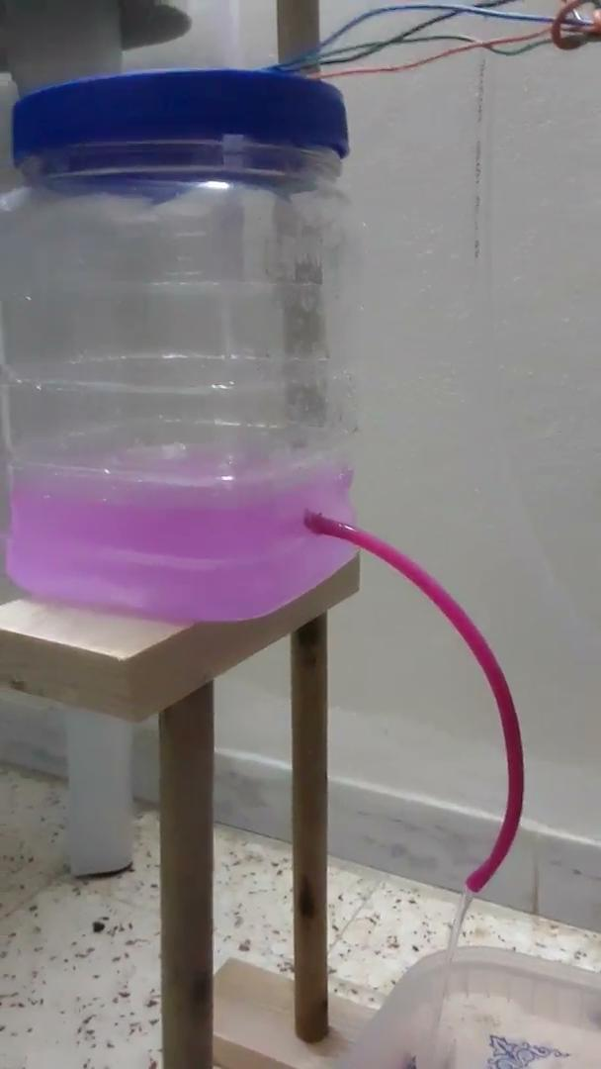

Slide 26
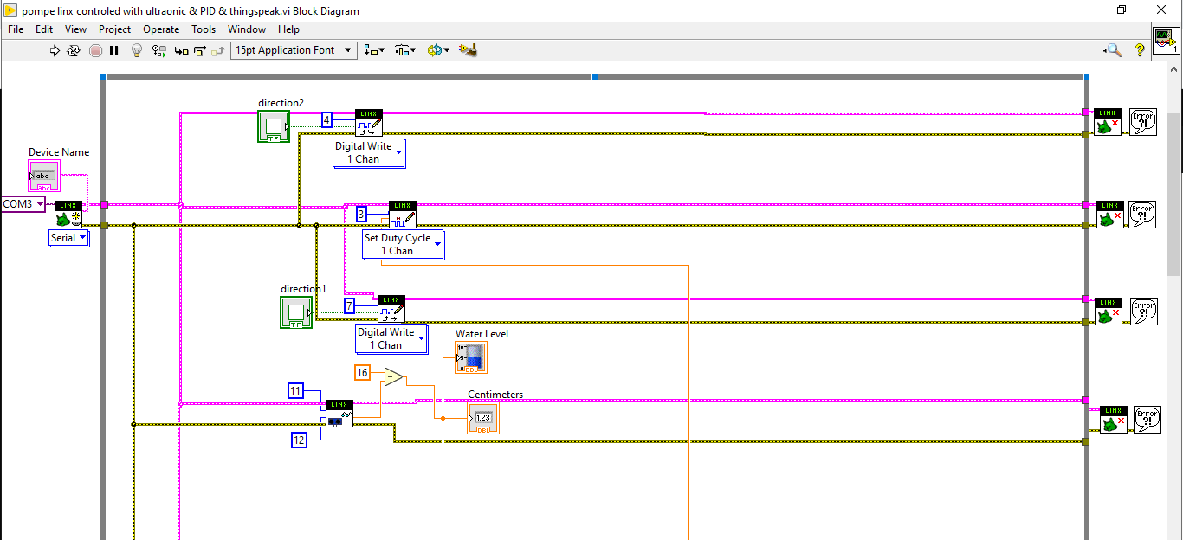
Block Diagram

Slide 27
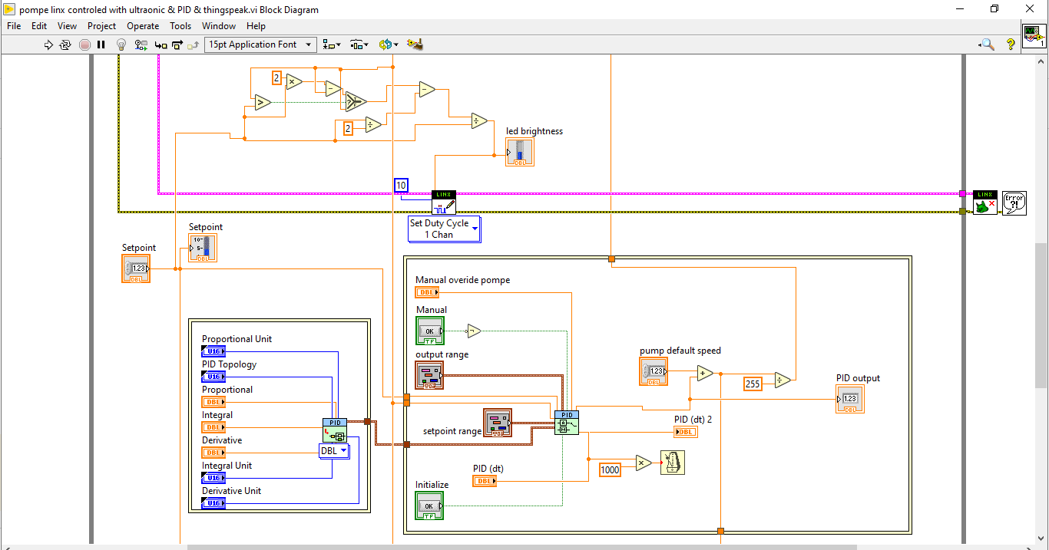

Slide 28
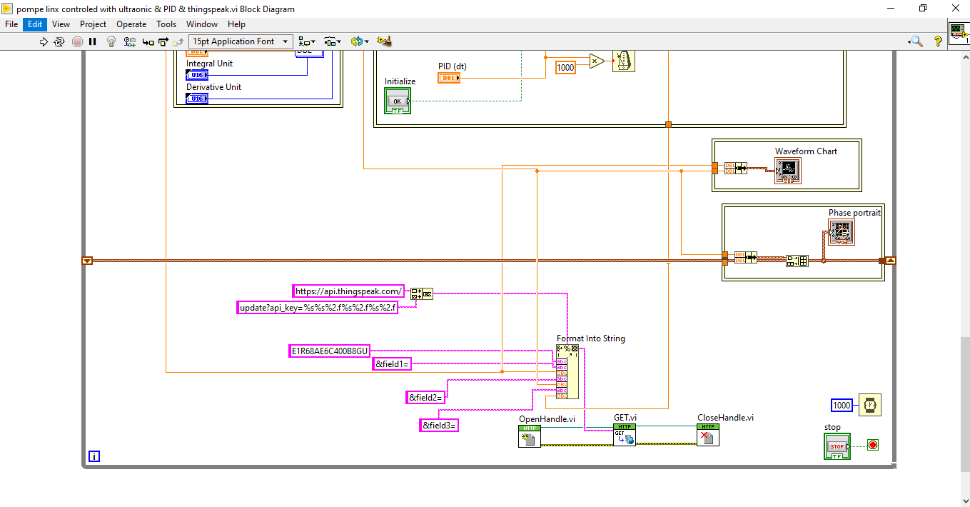

Slide 29
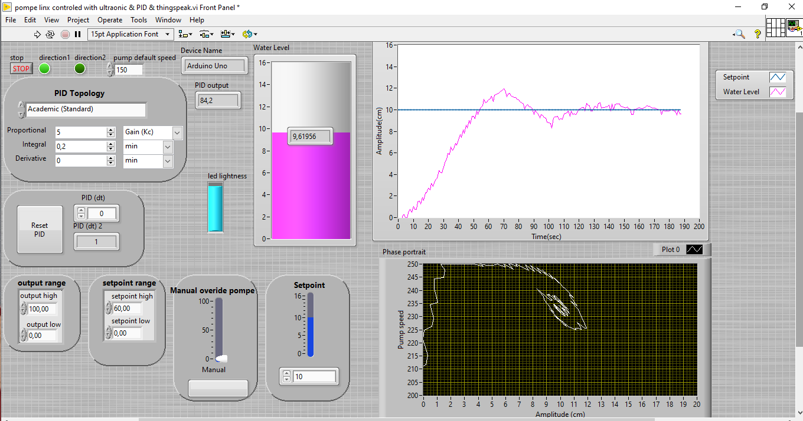
Front panel

Slide 30
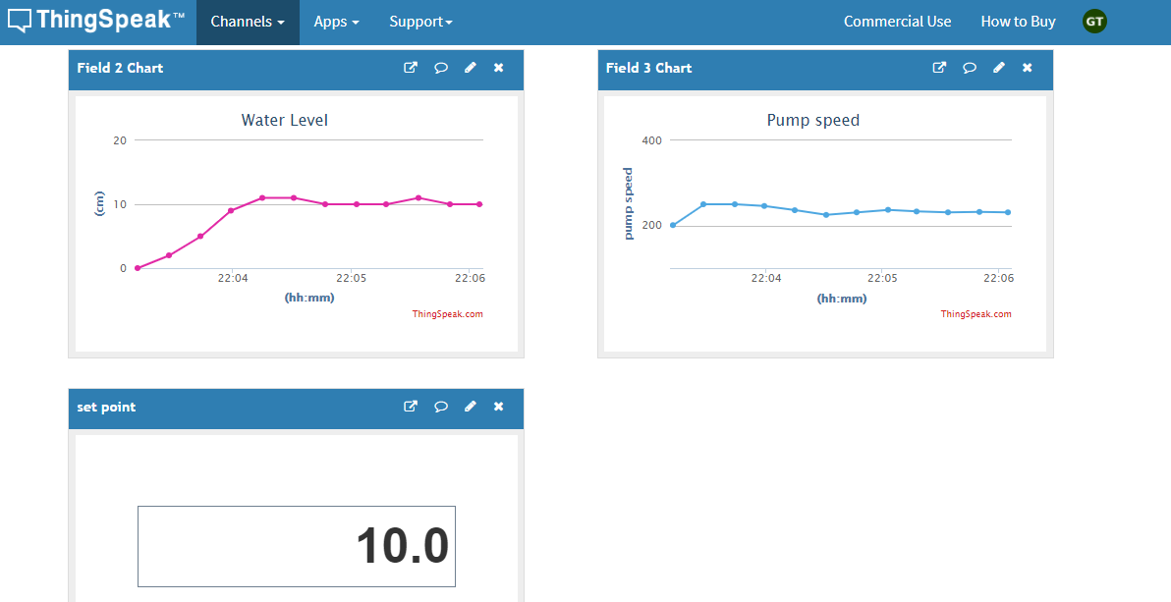
ThingSpeak

Slide 31
6.
Technical sales study

Slide 32
Technical Sales
Components | Costs
Pump | 28.5 dt
Arduino Uno | 40 dt
Ultrasonic Level Transmitters | 11 dt
Pipe | 2.5 dt
12 V Battery | 35 dt
Motor Driver Controller Board L298N | 15 dt
2 Tanks | 4.5 dt
TOTAL | 136.5 dt

Slide 33
7.
Conclusion & Perspectives

Slide 34
Conclusion
The Two tanks benchmark is a nonlinear system used in different areas : to ensure
that the entire system can run safely, smoothly and profitably.
But how can we improve it?
Theoretical idea
Mechanical conception
Electrical wiring
Labview Programing
IOT addition

Slide 35
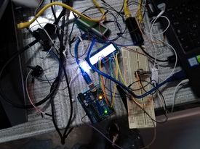
Perspectives
Using Fuzzy algorithm instead of pid to control the benchmark
Using protocol i2c to work with lcd instead of cabling lcd directly to the arduino
Using the site Thing speak to visualize the output charts instead of labview
Work on how to control the two tanks in a wireless way using iot and esp32 instead of arduino

Slide 36

Thanks!
Let’s hear your
questions!

